Slide 1
Attendance
Management
CSE (2017 - 2021)
Prachi Pallavi - B417025
Amarendra Prasad Sahu - B117005
Debasish Sahoo - B117019
Sachin Pathak - B117044
Manda Saahithi - B117026

Slide 2
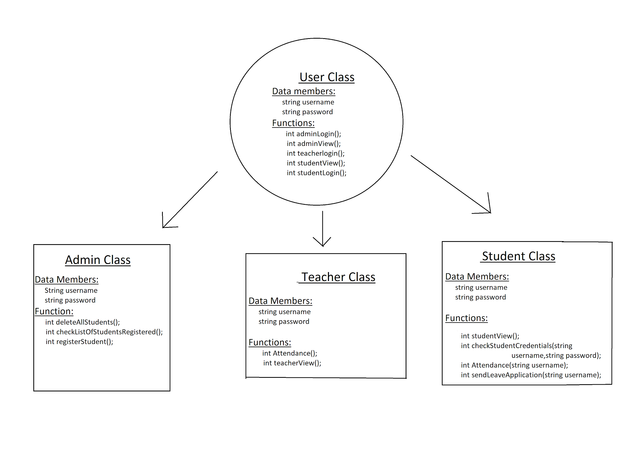
Basic Structure of project

Slide 3


Concepts used
Classes
Objects
Polymorphism
Inheritance
Header files
File Handling

Slide 4
Features Included
Students
Students can see their attendance as well as the %.
Students can send leave application
Admin
Register new students
See list of students along with their attendance.
Delete all students from database.
Teacher
Takes attendance of each student present in the class (database)

Slide 5
Sachin
Admin Login
Student Registration

Slide 6
Saahithi
Deleting all students from database
List of students Registered along with attendance

Slide 7
Prachi
Teacher Login
Attendance given to each students

Slide 8
Debasish & Amar
Student Login & checking Credentials
Counting attendance and displaying for students
Send leave application

Slide 9

Thank You

